Slide 1
WEEK 8 · LECTURE 15
Answering the Customer
Retrieval-augmented generation, and the engineering around it
A model that writes fluently, knows nothing about your company,
and cannot tell you where it got that. Tonight we fix all three.
Three discussions, no laptops required, and a working product at the end.
ISBA 2411 · Natural Language Processing & AI · Summer 2026

Slide 2
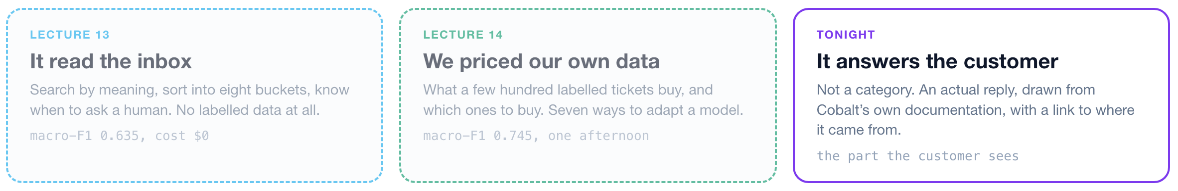
1 Grounding
2 Retrieval
3 Generation
4 Deployment
LECTURES 13 TO 15
Lectures 13 and 14 classified tickets. Lecture 15 answers them.
Same company, same inbox. What changes tonight is what the system produces at the end.
ISBA 2411 · Natural Language Processing & AI · Summer 2026

Slide 3
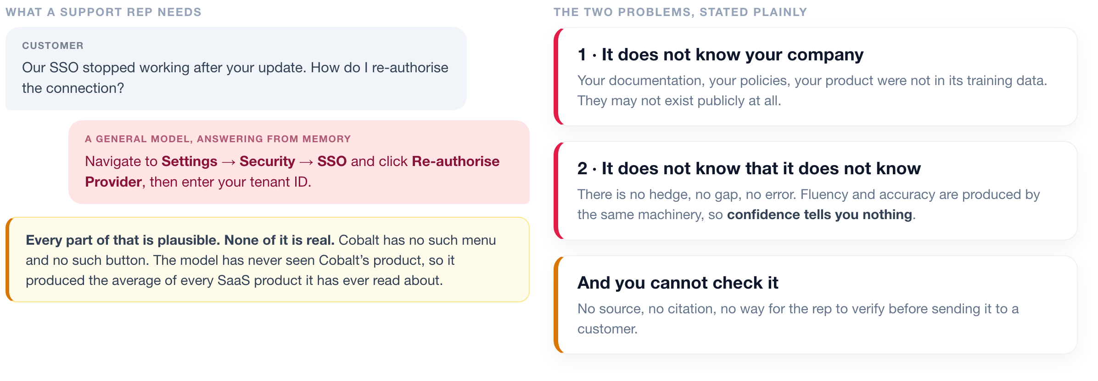
1 Grounding
2 Retrieval
3 Generation
4 Deployment
THE GROUNDING PROBLEM
A general model invents a menu that does not exist
A real Cobalt ticket, answered by a general model with no access to Cobalt's documentation.
ISBA 2411 · Natural Language Processing & AI · Summer 2026

Slide 4
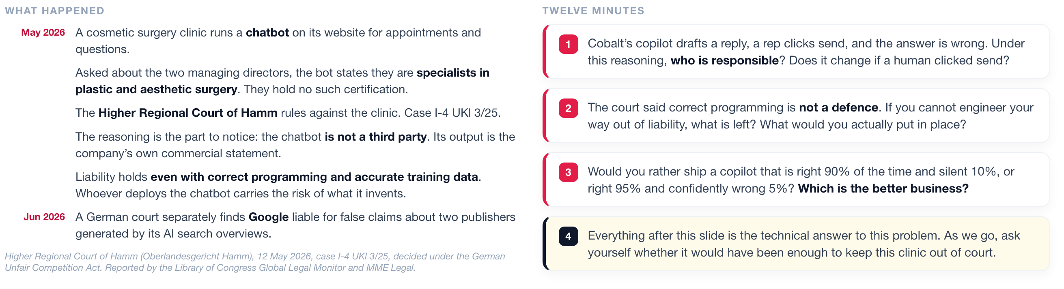
1 Grounding
2 Retrieval
3 Generation
4 Deployment
DISCUSSION 1
A court ruled the company liable for what its chatbot invented
Read the timeline, then take a position. We return to this at the end of the lecture.
ISBA 2411 · Natural Language Processing & AI · Summer 2026

Slide 5
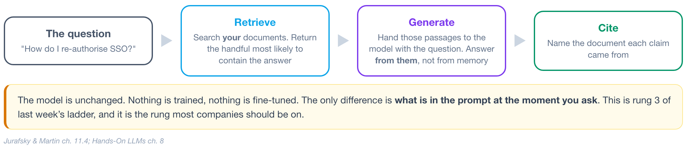
1 Grounding
2 Retrieval
3 Generation
4 Deployment
THE ARCHITECTURE
Four stages: the question, retrieve, generate, cite
Find the relevant documents first, then make the model answer from those and only those.
ISBA 2411 · Natural Language Processing & AI · Summer 2026

Slide 6
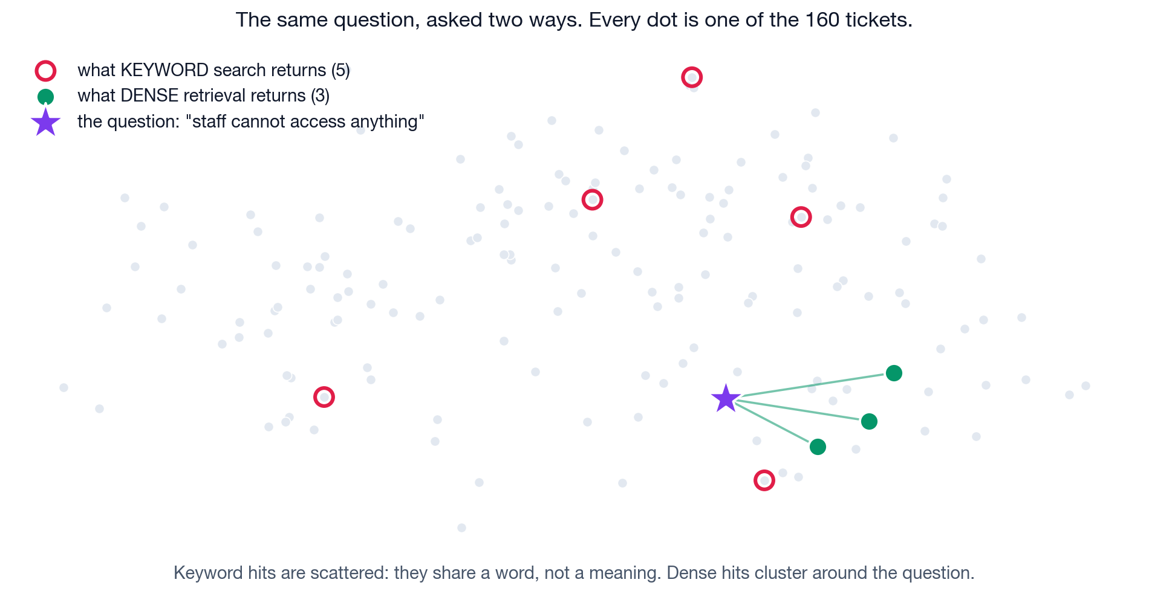
1 Grounding
2 Retrieval
3 Generation
4 Deployment
RETRIEVAL
Dense retrieval matches meaning, keyword search matches spelling
The real 160 tickets from Lecture 13, and the real question you asked of them.
Keyword search matched on the word “anything” and returned date pickers. Dense retrieval returned three people locked out, sharing no words with the question.
ISBA 2411 · Natural Language Processing & AI · Summer 2026

Slide 7
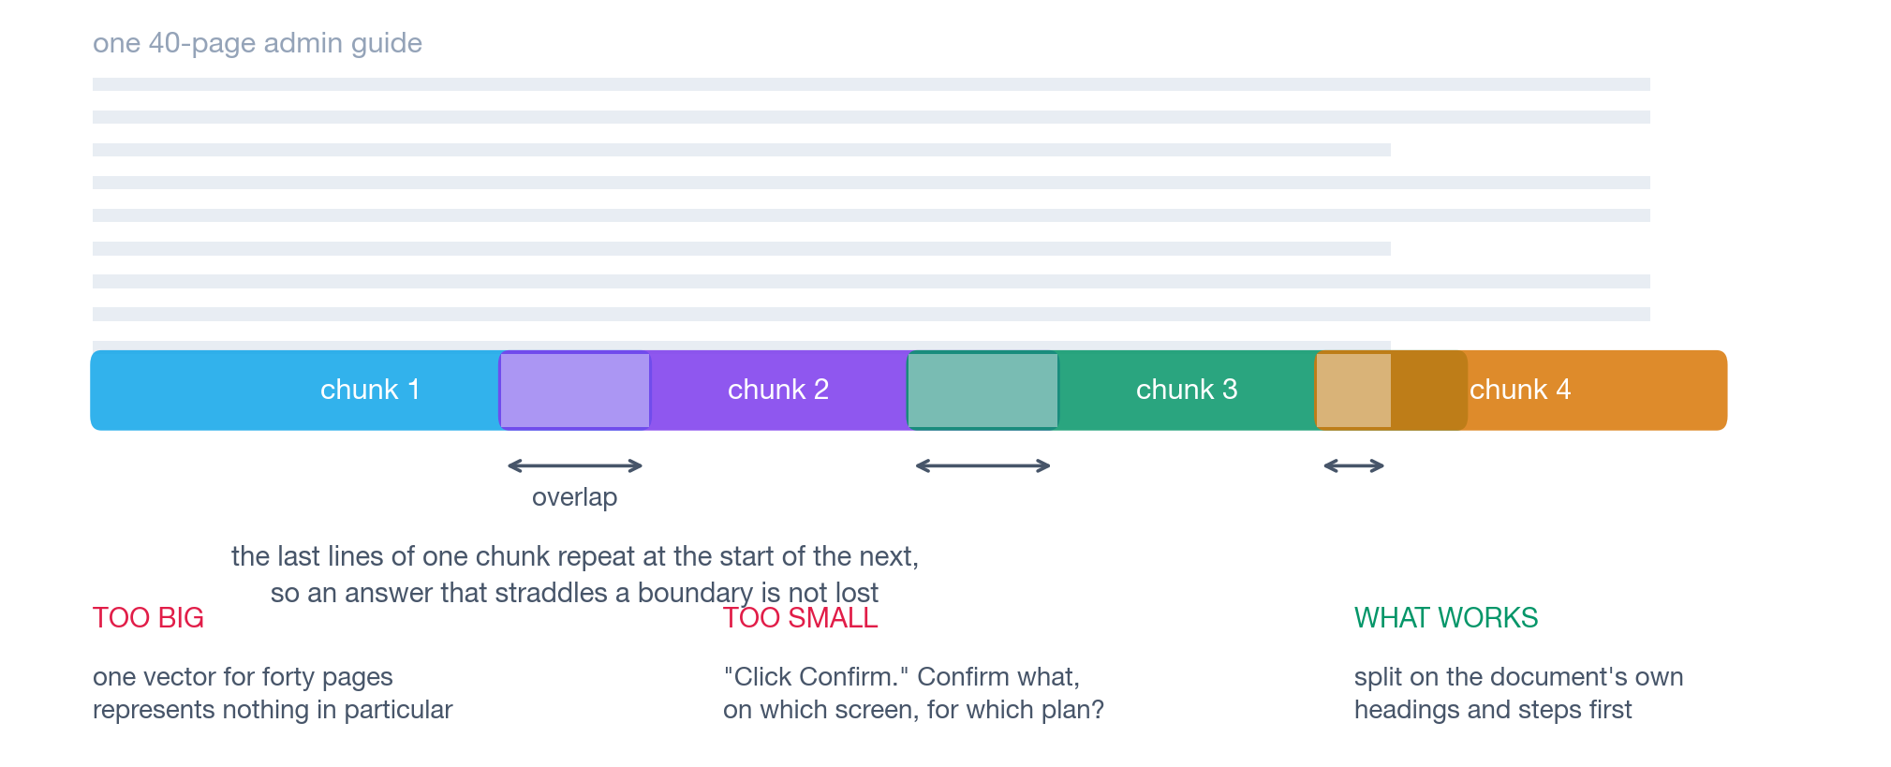
1 Grounding
2 Retrieval
3 Generation
4 Deployment
CHUNKING
Where you cut the documents decides what can be retrieved
Retrieval returns pieces of documents, not whole documents. Choosing the pieces is a design decision with real consequences.
ISBA 2411 · Natural Language Processing & AI · Summer 2026

Slide 8
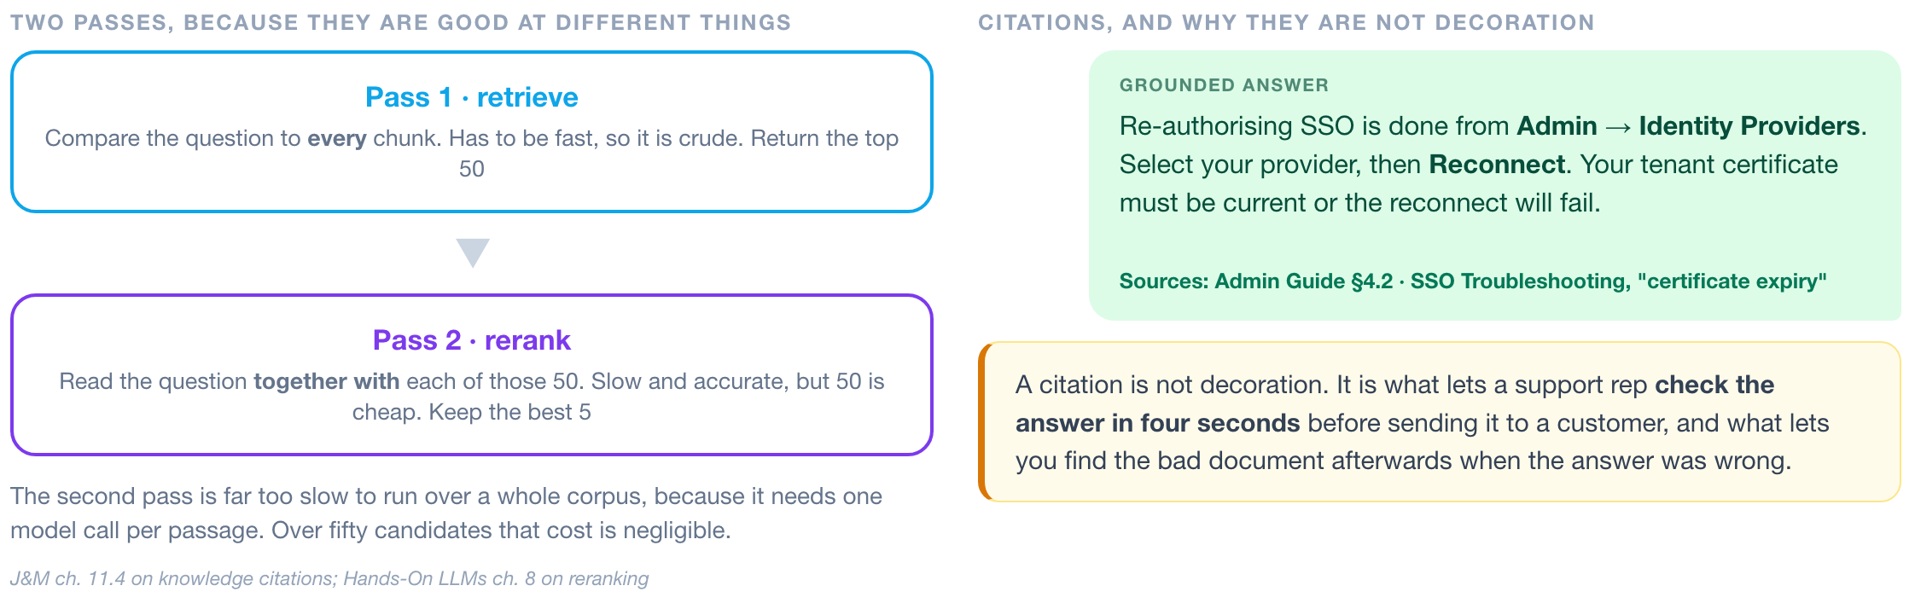
1 Grounding
2 Retrieval
3 Generation
4 Deployment
RERANKING AND CITATIONS
A second pass reads the question and the passage together
Then attach the source of every claim, because the rep has to check it before sending.
ISBA 2411 · Natural Language Processing & AI · Summer 2026

Slide 9
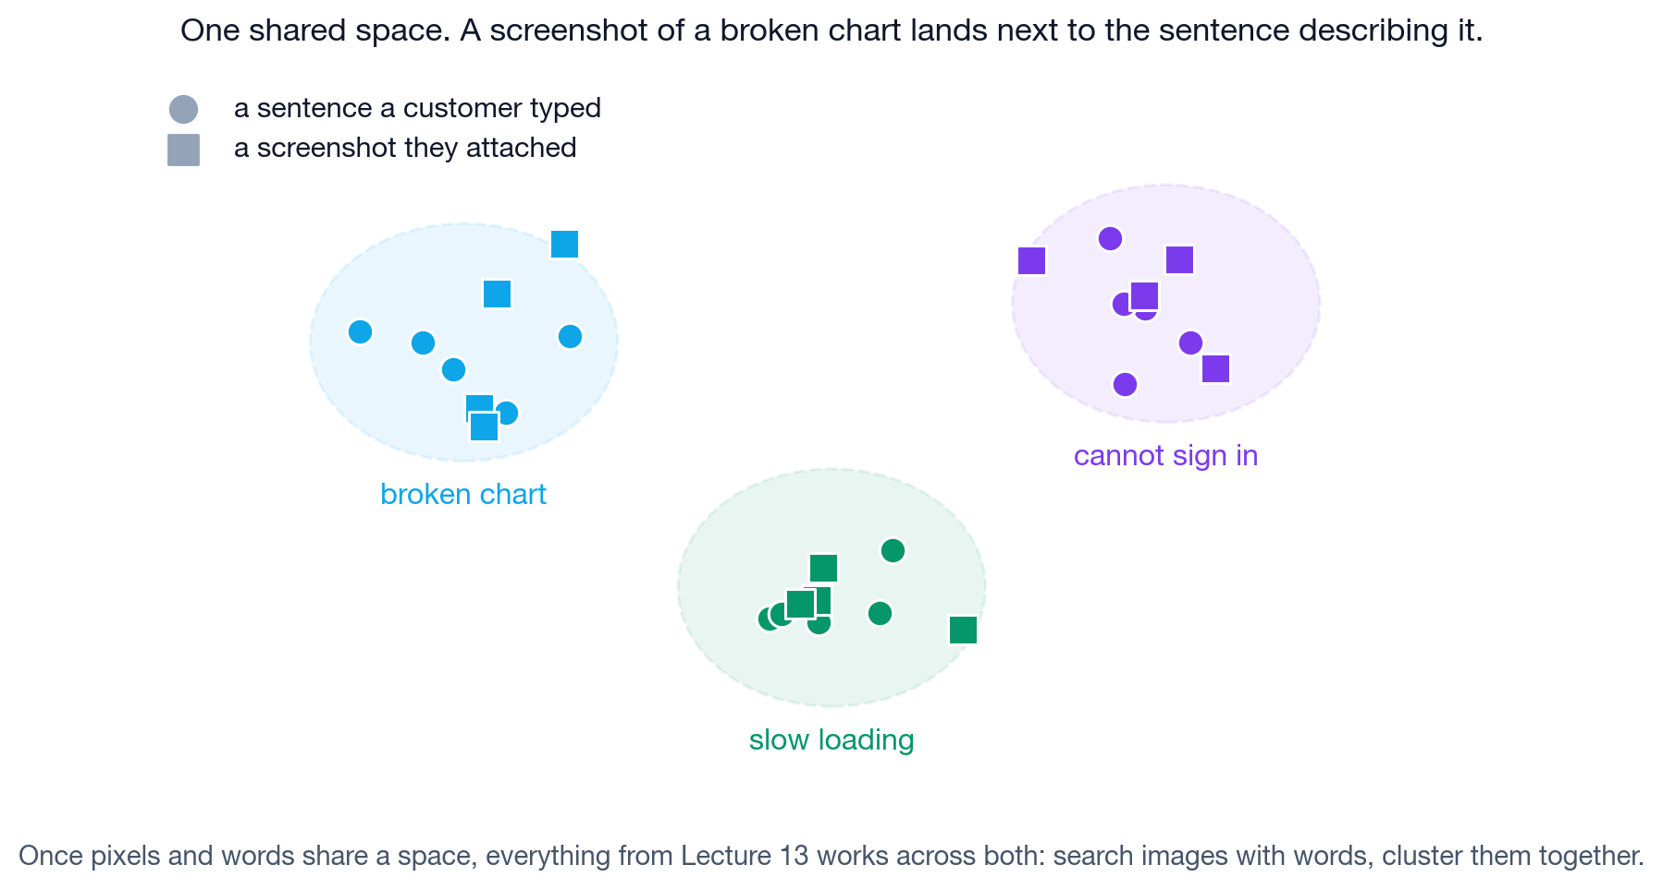
1 Grounding
2 Retrieval
3 Generation
4 Deployment
MULTIMODAL RETRIEVAL
CLIP puts images and text in the same vector space
The same shared-space idea from Lecture 13, extended to screenshots.
Roughly half of real support tickets arrive with a screenshot. Until now our copilot has been blind to every one of them.
ISBA 2411 · Natural Language Processing & AI · Summer 2026

Slide 10
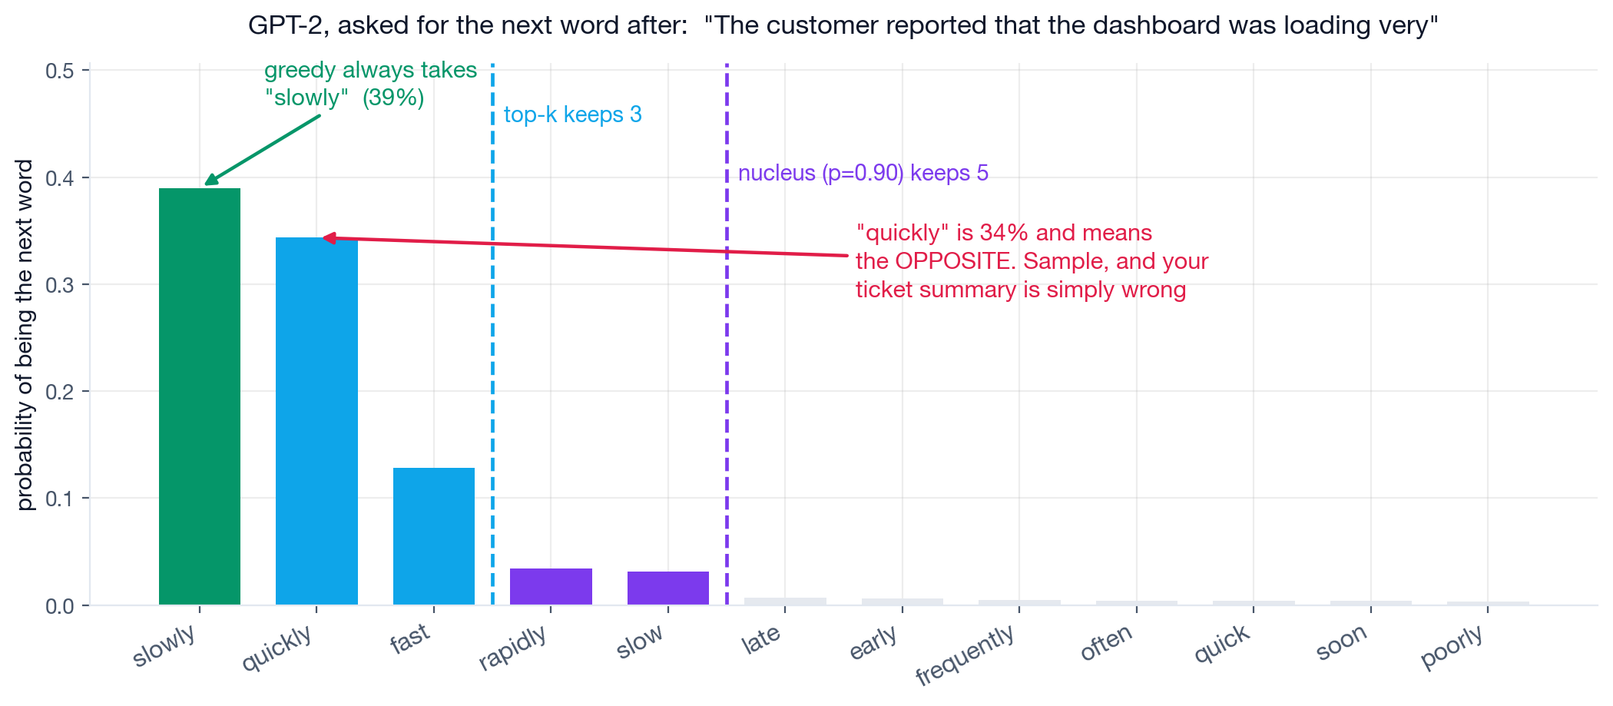
1 Grounding
2 Retrieval
3 Generation
4 Deployment
DECODING
Greedy, beam search and sampling, from one set of probabilities
Real GPT-2 probabilities. One setting decides which word comes out, and whether you can audit it.
Greedy is reproducible and boring, which is what a support answer should be. Sampling is for drafting and marketing, where variety is the point.
ISBA 2411 · Natural Language Processing & AI · Summer 2026

Slide 11
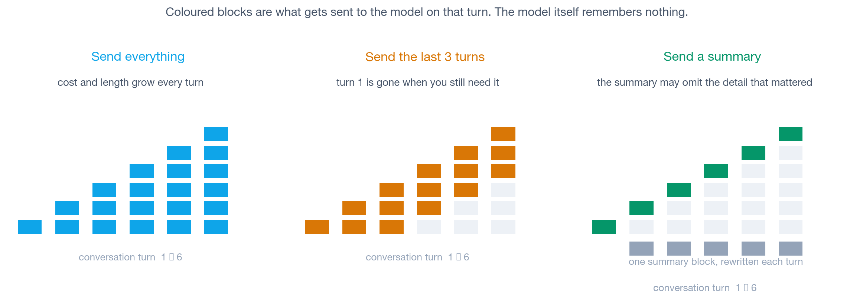
1 Grounding
2 Retrieval
3 Generation
4 Deployment
MEMORY
The model has no memory, so the application has to supply it
Every request arrives with no history. Three ways to supply it, three failure modes.
Everything that looks like memory in a chat product is a decision about what to paste back in, and each option has a failure mode your customers will find.
ISBA 2411 · Natural Language Processing & AI · Summer 2026

Slide 12
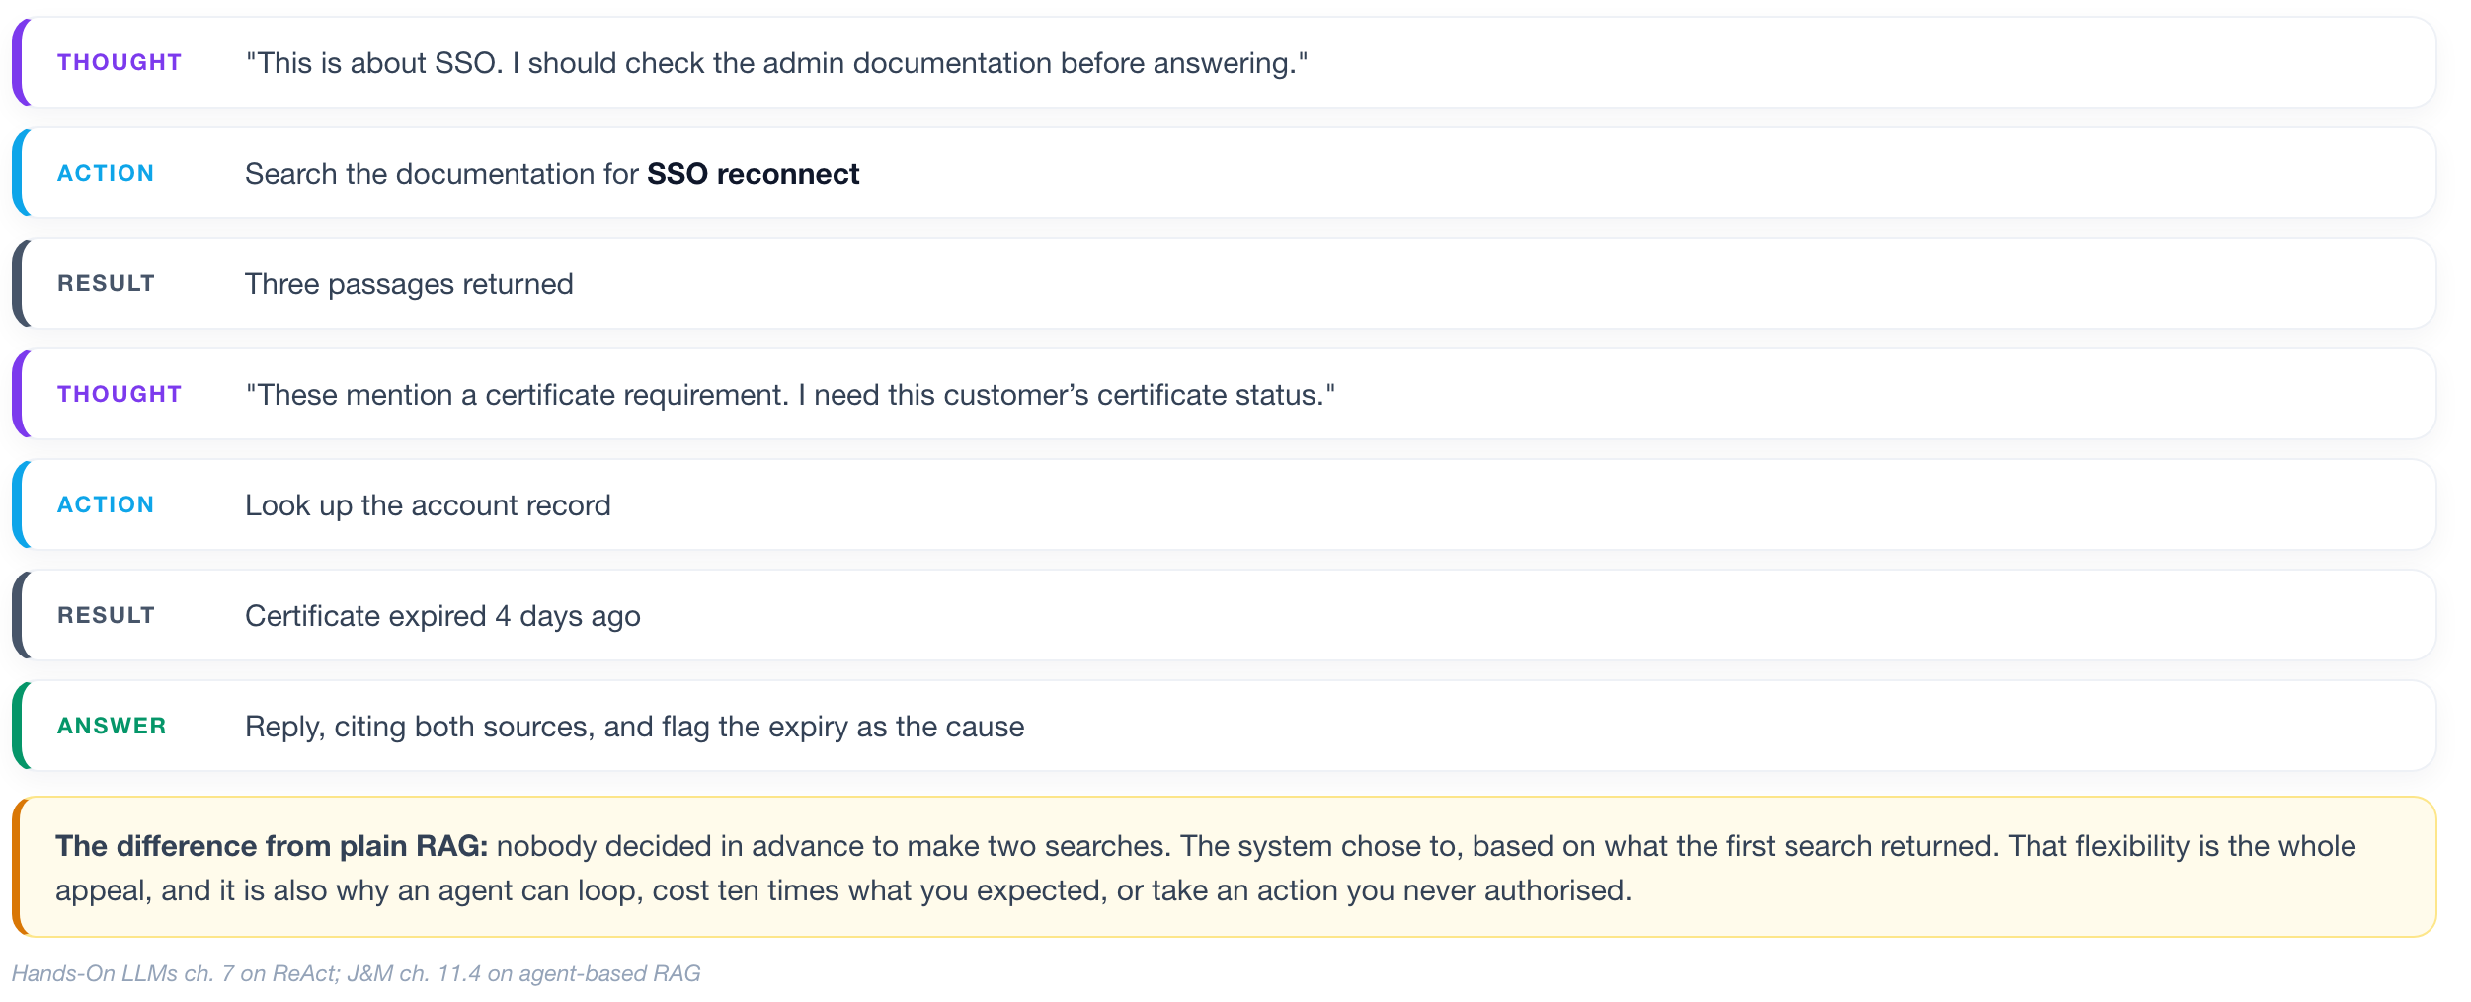
1 Grounding
2 Retrieval
3 Generation
4 Deployment
AGENTIC WORKFLOWS
An agent chooses its own retrieval steps, one at a time
The same ticket, but the system chooses its own steps instead of following a fixed script.
ISBA 2411 · Natural Language Processing & AI · Summer 2026

Slide 13
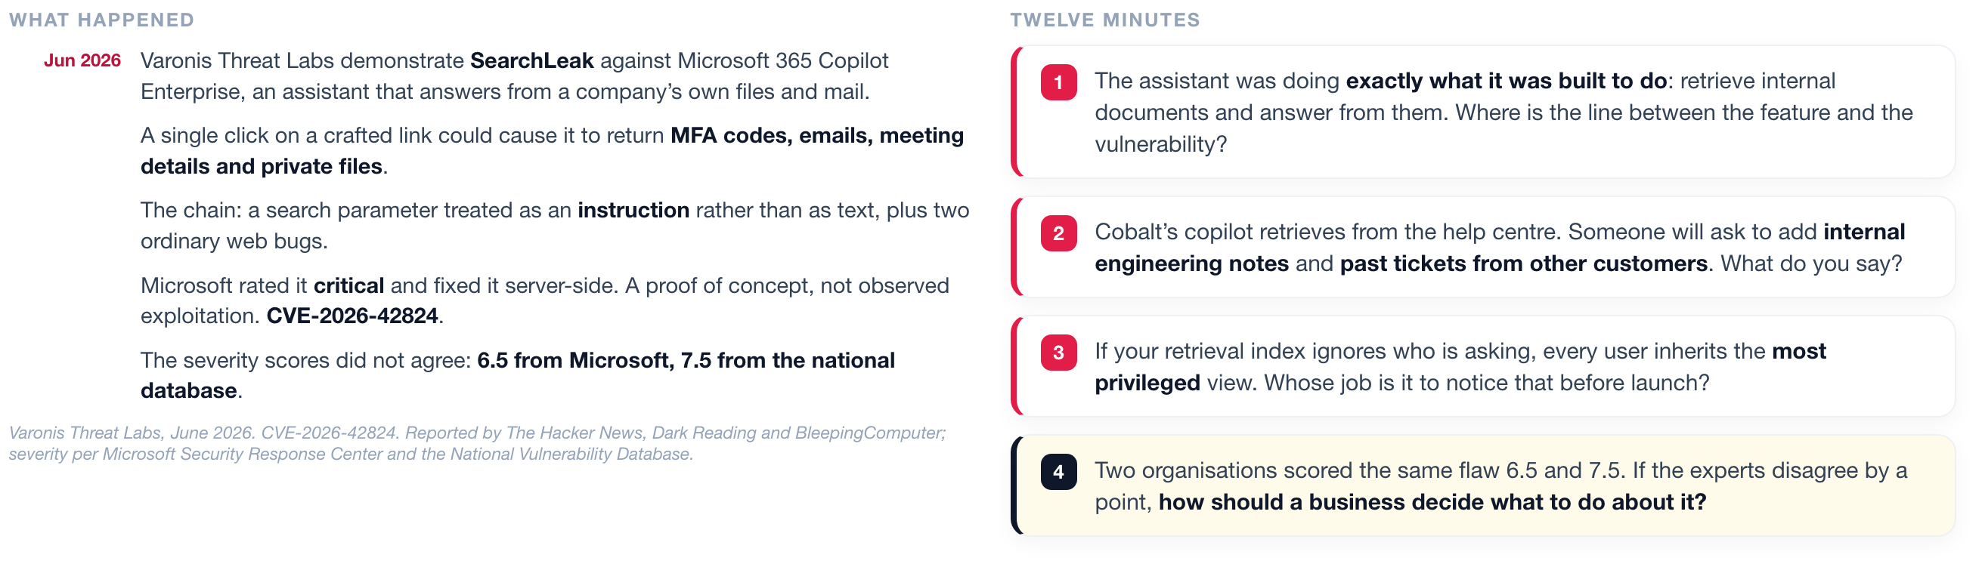
1 Grounding
2 Retrieval
3 Generation
4 Deployment
DISCUSSION 2
One crafted link made Microsoft 365 Copilot return private files
A retrieval assistant working exactly as designed, and why that is the problem.
ISBA 2411 · Natural Language Processing & AI · Summer 2026

Slide 14
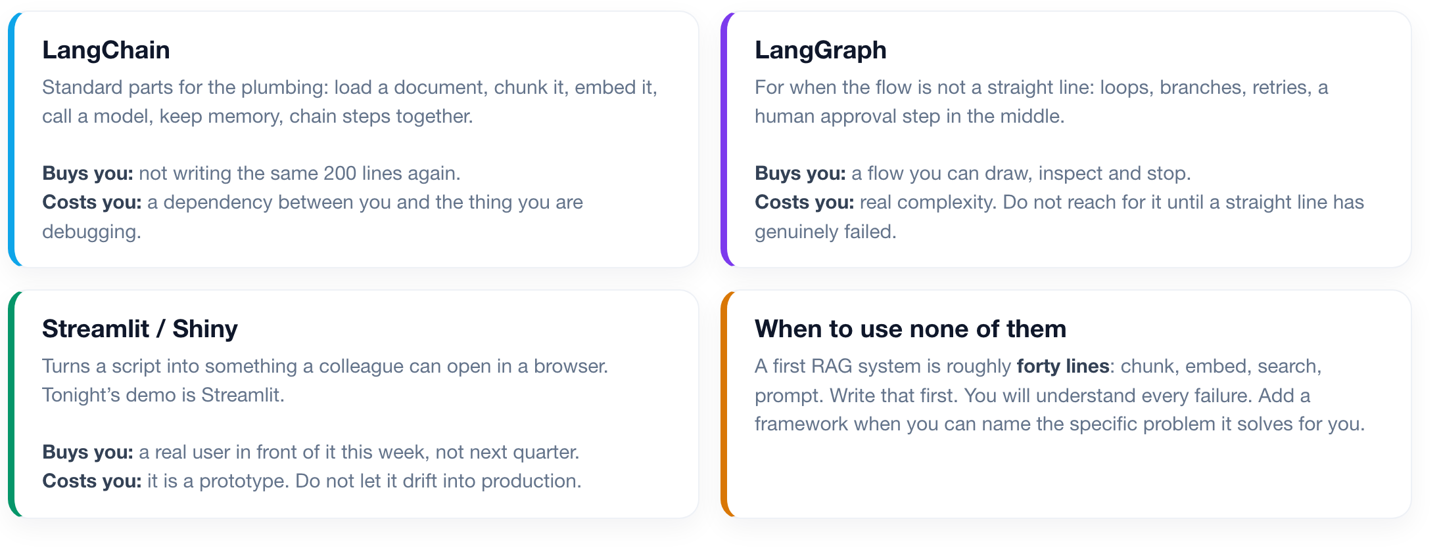
1 Grounding
2 Retrieval
3 Generation
4 Deployment
FRAMEWORKS
LangChain, LangGraph and Streamlit: what each one is for
What each one buys you, what it costs you, and when to use none of them.
ISBA 2411 · Natural Language Processing & AI · Summer 2026

Slide 15
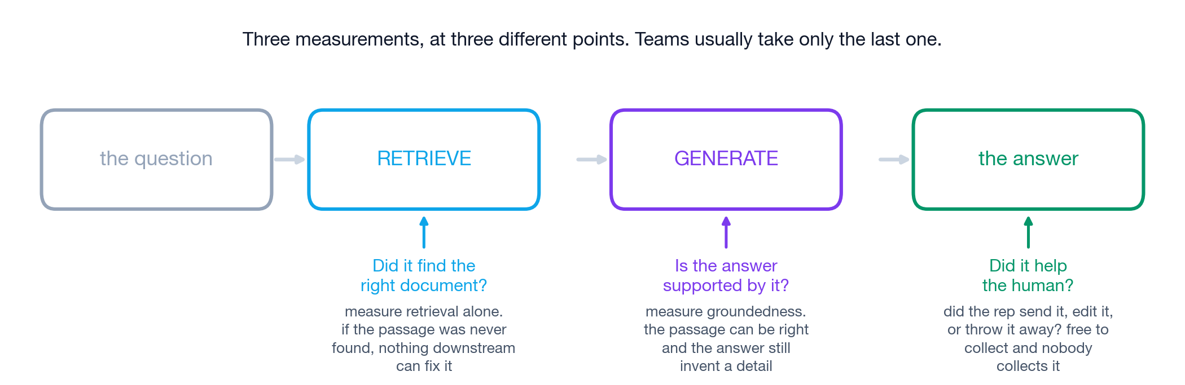
1 Grounding
2 Retrieval
3 Generation
4 Deployment
EVALUATION
Retrieval, groundedness and acceptance are measured separately
Retrieval and generation fail in different ways, so they have to be measured separately.
Retrieval and generation fail in different ways. Measure them apart or you will not know which half to fix.
ISBA 2411 · Natural Language Processing & AI · Summer 2026

Slide 16
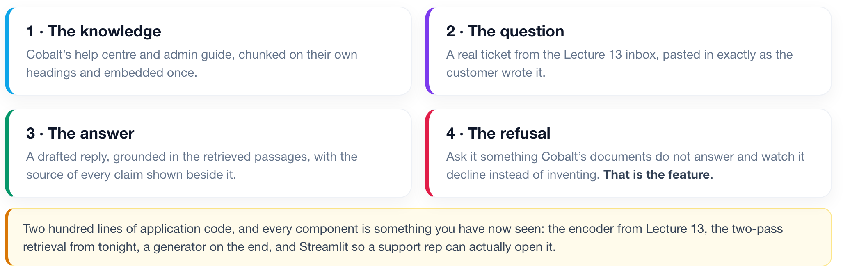
1 Grounding
2 Retrieval
3 Generation
4 Deployment
THE DEMO
The Cobalt Support Copilot, running end to end
Watch rather than follow along. The code is on the course repo if you want it.
Every control in the sidebar is a decision from tonight. We change one and watch what it does to the answer.
ISBA 2411 · Natural Language Processing & AI · Summer 2026

Slide 17
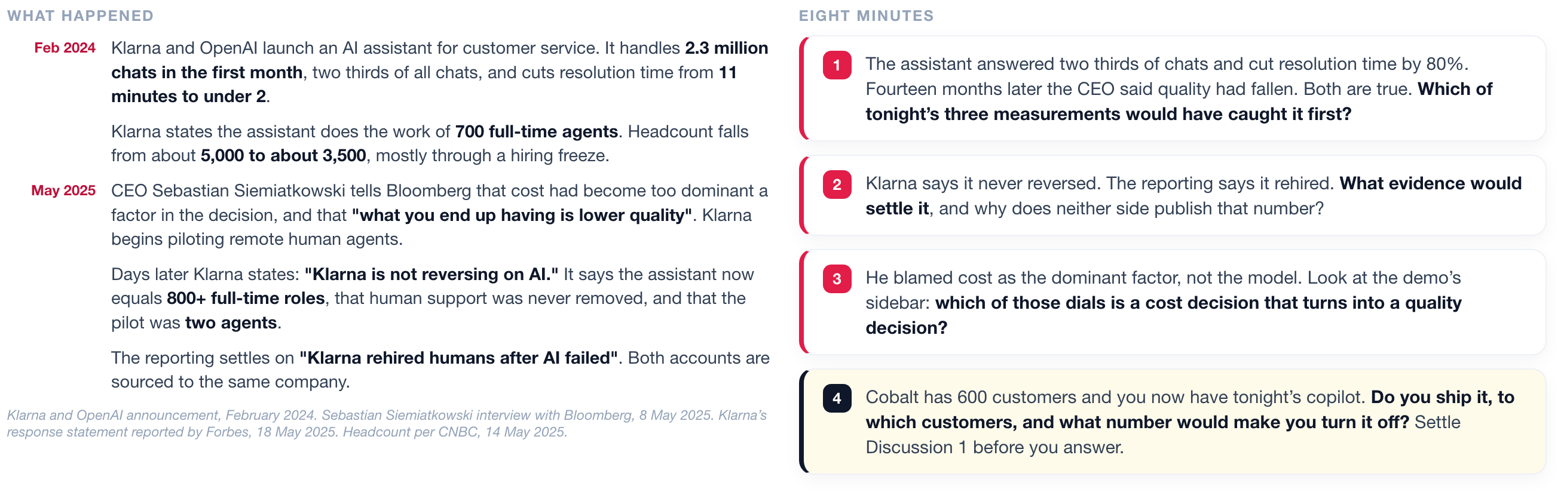
1 Grounding
2 Retrieval
3 Generation
4 Deployment
DISCUSSION 3
Klarna shipped this at scale, and the accounts of what happened disagree
You have now built one. This is a company that deployed it to millions of customers.
ISBA 2411 · Natural Language Processing & AI · Summer 2026

